Slide 1
RESUME WIZARD
A Web Application For Making Resume.
Md Nomaan Zeya CSE/123/21
Mrityunjay Kumar Gupta CSE/124/21
Anshul Singh CSE/097/21

Slide 2
BASIC IDEA
To build an web application where we can make eye catching resume.
The details will be collected in section wise.
The user will also be able to print and download the resume.

Slide 3
PLAN
Tech Stack Used:-
HTML,CSS,JAVASCRIPT
Structure: Create HTML templates for user input, sections, and layouts.
Style: Apply CSS for design, typography, and responsive formatting.
Functionality: Use JavaScript for dynamic input validation and real-time preview.
Export: Enable users to download the resume in PDF or other formats.

Slide 4
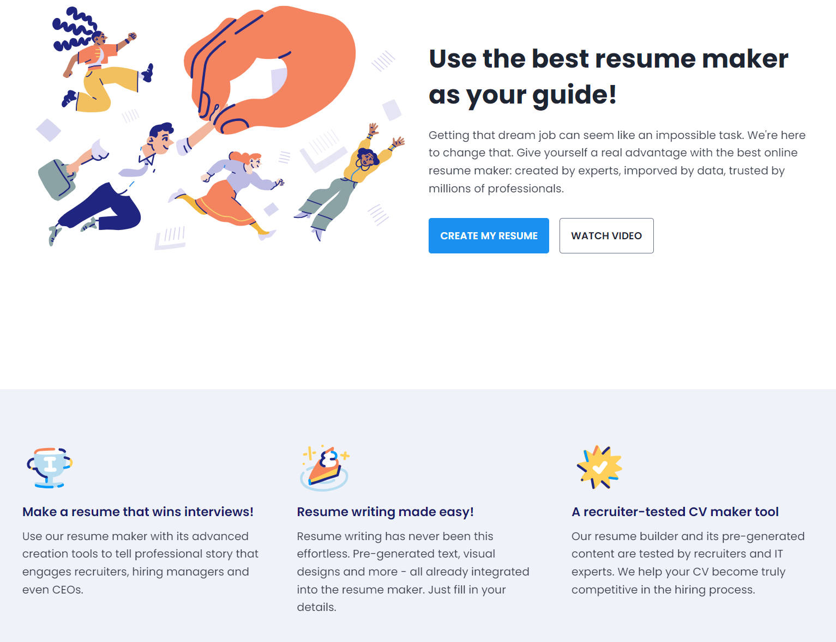
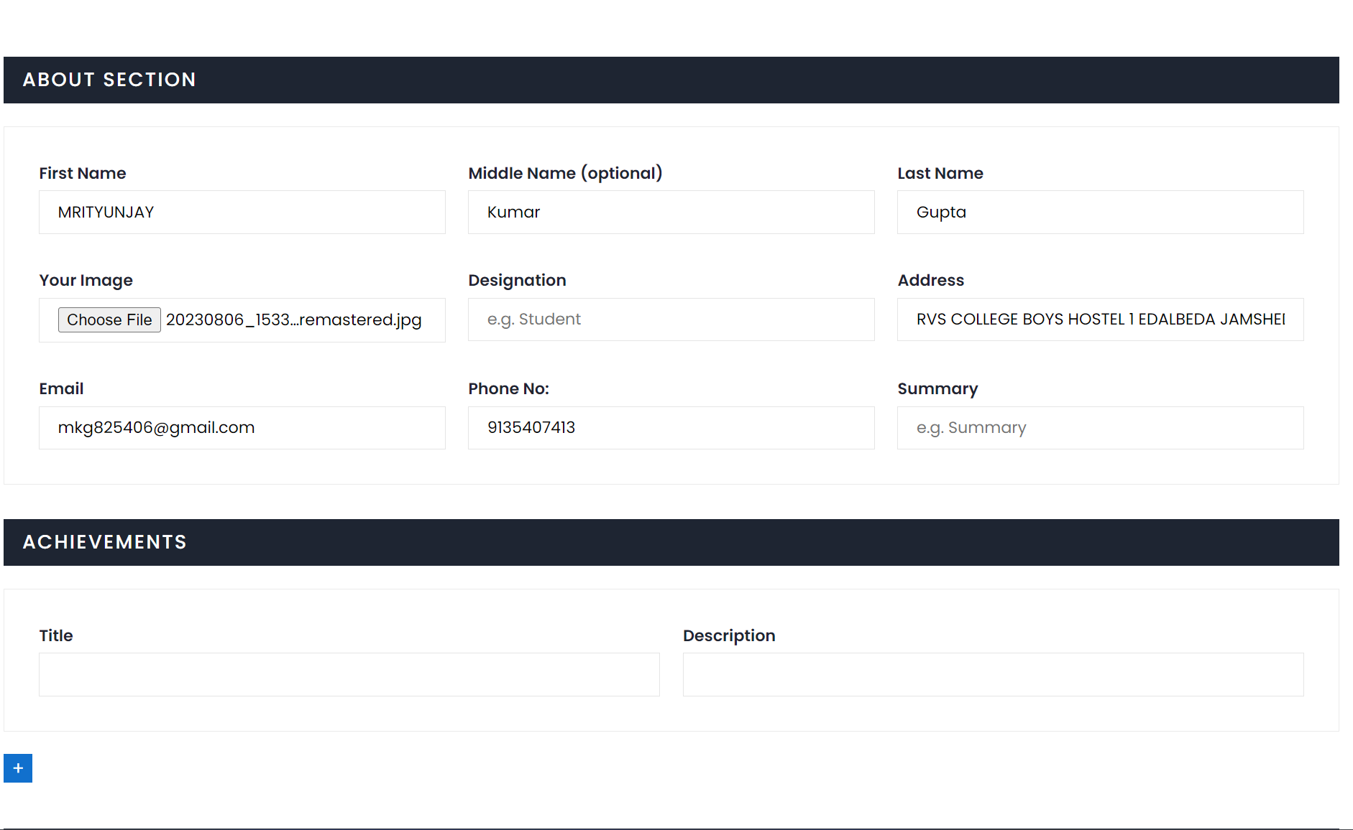
SOME SCREENSHOTS

Slide 5
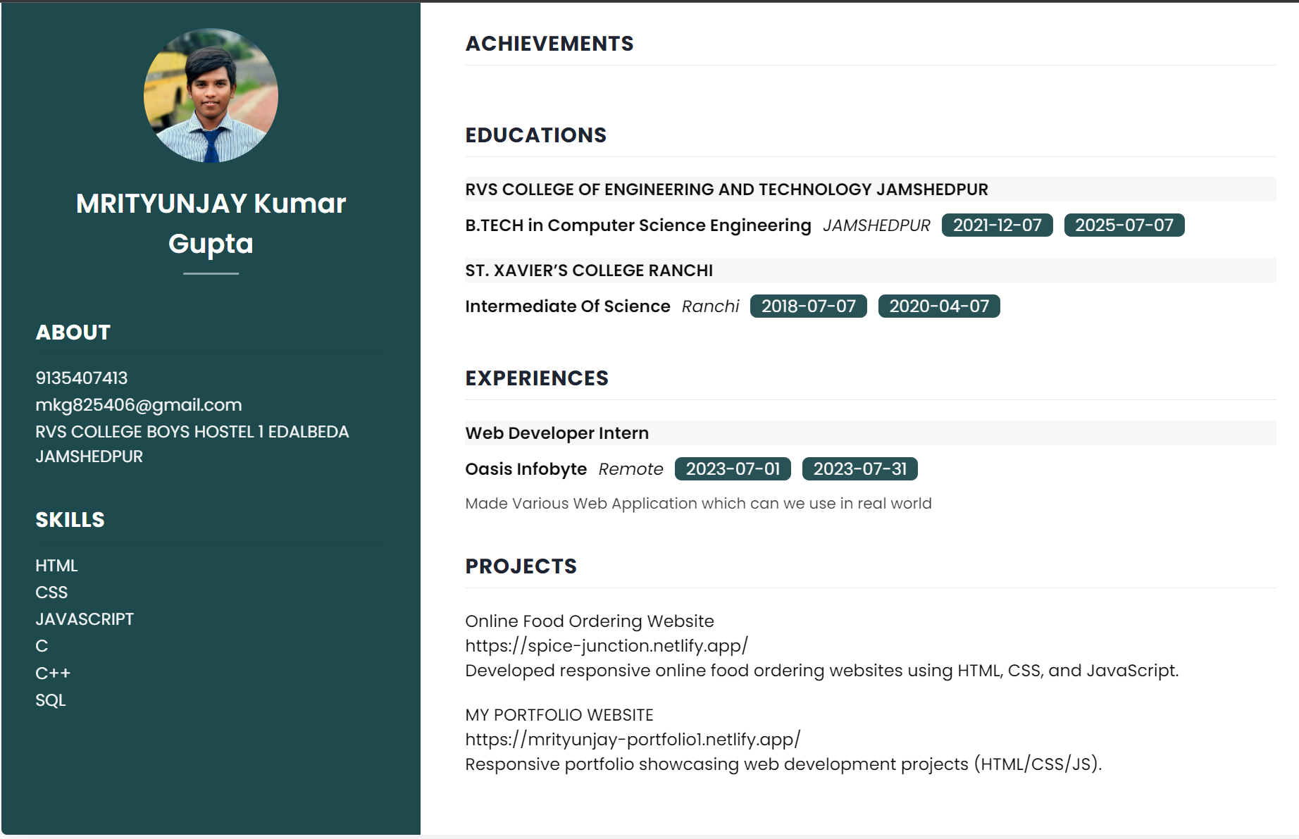

Slide 6
LIMITATIONS
Internet connectivity is a must.
Only One Template will be available.
It can’t store Your Data after refresh or reload.
FUTURE PLANS
Multiple Templates will be available.
User authentication will be available.
You can store you details in web application.

Slide 7
CONCLUSION
To build an web application where we can make eye catching resume.
During the course of development our group learned many things about the android development, firebase, etc.
Also learned how to work with a group when its about developing something together.

